Slide 1
Pivot Table and Pivot Charts
Presenter: Jolanta Soltis

Slide 2
If you have not used pivot tables before, you are about to discover one of the most powerful data analysis tools of Excel…
Pivot tables have been used successfully with data sets containing over 800,000 records. It is recommended that, for large data sets, you use at least a 133MHz Pentium with 32MB of RAM. The amount of physical RAM is more important than processor speed when working with large pivot tables.

Slide 3
Contents
A simple Pivot Table
  Using the Wizard to set up a simple table
  Adding Row Fields
  Creating another Pivot Table based on an existing Table
A more complex example
  Using Page Fields
  Hiding data
  Grouping data
  Field calculations

Slide 4
3. Pivot Tables based on external data
4. Using Pivot Tables to consolidate data
5. Using calculated fields

Slide 5
Data
Data arranged in a list:
  Columns represent fields
  Rows represent a record of related data
First row = column label
Columns contain one sort of data
  For example, text in one column and numeric values in a separate column

Slide 6
Understand your data
Ask yourself what you want to know
Remember the rules of where to place data fields:
  Row Fields: display data vertically, in rows
  Column Fields: display data horizontally, across columns
  Data Items: numerical data to be summarized
  Page Fields: display data as pages and allows you to filter to a single item

Slide 7

A simple Pivot Table
Using the Wizard to set up a simple table
You have a list of data as given in the worksheet EG1.XLS.

Slide 8
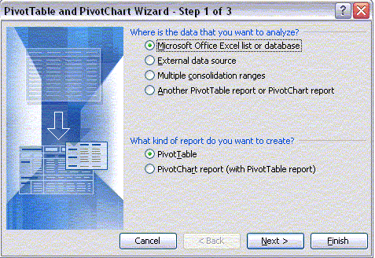
To create a Pivot Table, first highlight any cell in the data, then click on the menu Data - PivotTable… You should see the following dialog.
For now, you want to analyze the data contained in the Excel list, so click the Next
Notes:
The Pivot Table Wizard dialog appears. For now, you want to analyze the data contained in the Excel list, so click the Next button. This sends you to the next dialog, which shows the range containing the data you wish to analyse. Excel automatically selects all the data in a contiguous range about the highlighted cell, that means this step is all done for you so just click Next.

Slide 9
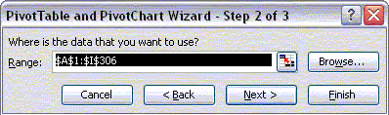
Excel automatically selects all the data in a contiguous range about the highlighted cell, click Next

Slide 10
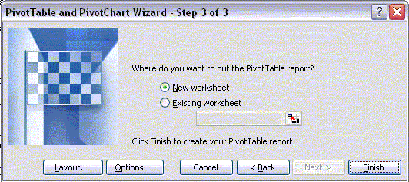
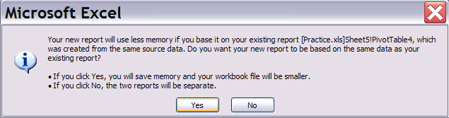
The third dialog asks whether you want to put the pivot table on the existing worksheet or on a new sheet.
Select "New Worksheet" then click the Layout button.
Note: If you get the below message and you are concerned about file size, click Yes

Slide 11
Changing the layout takes only seconds, so don’t worry about making it perfect the first time.

Slide 12
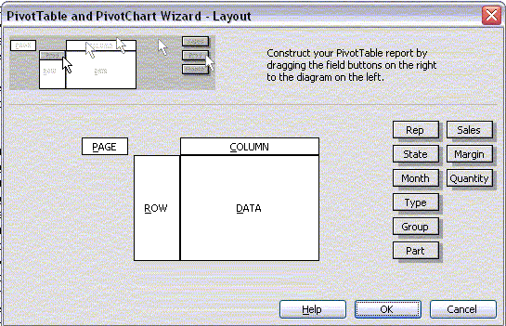
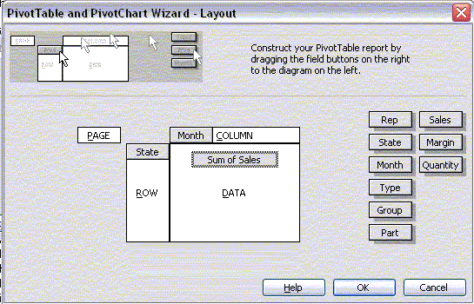
You can click-and-drag the buttons on the right of the form to any of four areas on the Pivot Table.
Drag "State" to the Row area, "Month" to the Column area, and "Sales" to the Data area.
Click OK and Finish.

Slide 13
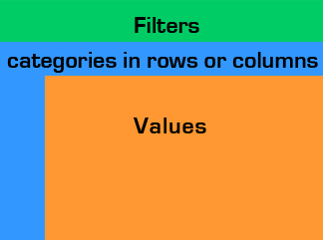
The Structure of a Pivot Table
Determine how much of the data is reviewed .
How you want to view data: year, school, instructor , gender.
Aggregate data items: math scores.
Notes:
Orange: Aggregate Data:
The center is where you would put your aggregate data item(s). Let’s say for example math scores that represent the overall aggregate of your classroom, school, or district.
Blue: Categories: Row or Column Items:
Then you would decide how you want to sort and view your data by dragging a field into the row or column area. Say you want to break up your data by year, district, school, instructor, benchmarks, or
gender.
Green: Filters: Page Items:
The page items section at the top of the table, allow
you to filter and sort the data further to determine
how much of the data is reviewed.

Slide 14
Page variables | Title
 | Row variables
Column variables | Data

Slide 15
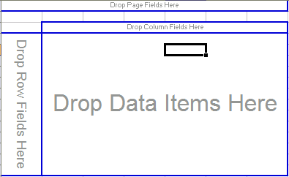
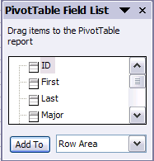

Summarized data
In row and column headings, use the down arrows to bring up a list of data values that can be clicked “on” or “off.”
Notes:
Note that that was a fast operation. The list you just summarised contains 305 records. This is not a lot of data compared to some Pivot Tables that you will prepare at work. It is enough to show you that Pivot Tables are fast. You are limited only by memory in the number of records that you can summarise in a Pivot Table. They are well suited to analysing large amounts of data.

Slide 16
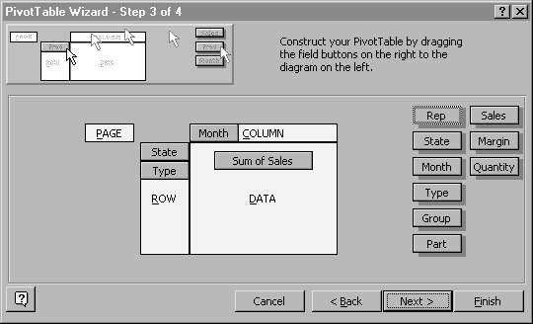
Adding Row Fields
Drag the Type button to the Row area under the State button. The Wizard will look like this:
Click Finish.
What type of product was sold in each State?
Notes:
Now lets try to make this a bit more complicated. What if you wanted to see what type of product was sold in each State? Select any cell within the existing Pivot Table, then select the menu item Data - Pivot Tables… you will go back to the Wizard at step 3.

Slide 17

Your Pivot Table now contains both State and Type Fields, and the data is nicely subtotaled.

Slide 18
Exercise
There are limits on how many fields you can drag to the Row and Column areas. Experiment with the Pivot Table and see if you can find these limits.

Slide 19


Once you have a table, pivot it!

Slide 20
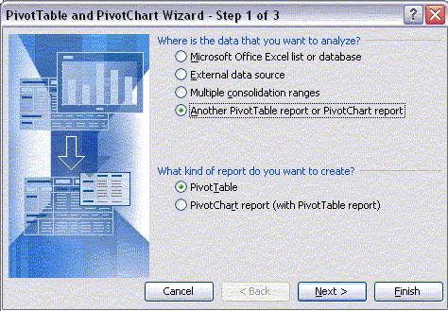
Creating another Pivot Table based on an existing Table
Select a blank cell on your worksheet and start the Pivot Table Wizard.
On the first screen, check the option button that says the data resides in Another Pivot Table.
Then Click Next.
Notes:
Now, let say we want to see both Sales and Margin side by side so that we can compare them. We could create another pivot table. It is better to base the new Pivot Table on the existing Pivot Table, because this way Excel uses the same memory cache for both Pivot Tables thus making sure you do not run out of memory on large Tables.

Slide 21
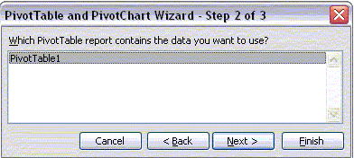
The Wizard asks you to select an existing Pivot Table, select PivotTable1 and Click the Next button.

Slide 22
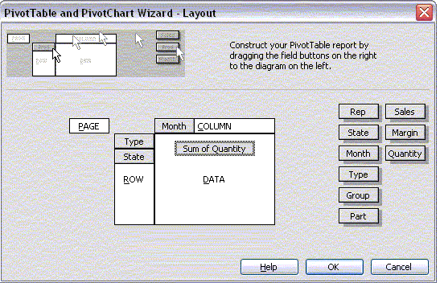
Create a Pivot Table as shown below and Click the Finish button. Place it in the same worksheet.

Slide 23
Now you should have two Pivot Tables on your worksheet.
Notes:
The completed workbook is given in EG2.XLS.

Slide 24
A more complex example
Open the workbook EG3.XLS.
Select a cell anywhere in the Pivot Table.
Then bring up the Pivot Table Wizard by using menu item Data - Pivot Table… or by Clicking the Pivot Table Wizard toolbar button.
Drag the Type Field button from the Row area to the Page area.

Slide 25
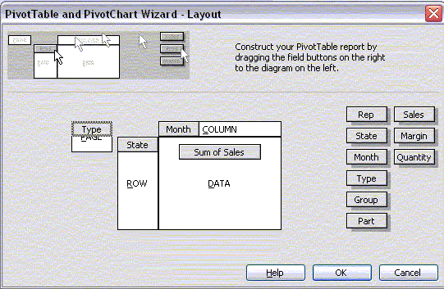
Click the Finish button.

Slide 26

Notice that sales for all product types are shown, and that a small arrow is placed beside the (All) label next to the Type field.
Click on this small arrow, a dropdown box appears that allows you to select one of the Type values (either Red or White).
Try this and watch the data change to show just White or Red products.

Slide 27
Hiding data
In the preceding example, the State WA does not have a good sales record. We would like to show what total sales would look like without this State.
First, click on the State field arrow. Select WA from the Hide items: list and Click the Finish button.
The Pivot Field now shows all States except WA.

Slide 28
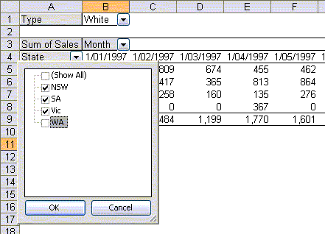

Slide 29
Grouping data
It is a little difficult to pick trends over the twelve month data period.
Select the Month field by Clicking on the Month label on the Pivot Table. Then use menu item Group and Show Details – Group. A dialog will ask how you wish to group the Month Field, select the Quarters option.

Slide 30
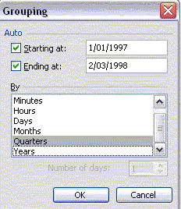

Slide 31
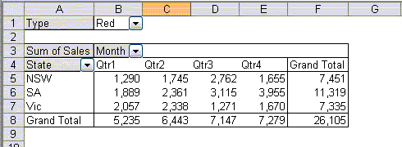
Double click on data area heading to set aggregate measure (e.g., sum, count, average), format cells (select “number,” then data format), or set options as to how data is shown (select “options,” then can show as % of row, column, etc).
Now your Pivot Table should look like this
Double click on row or column headings to format cells, toggle subtotals on or off (in this example, generic name subtotals are “off”) or do sorts based on data field (e.g. by # of Rxs)
Want to look at specific values in more detail? Double click on the cell of interest and all supporting data will come up in a new worksheet.

Slide 32
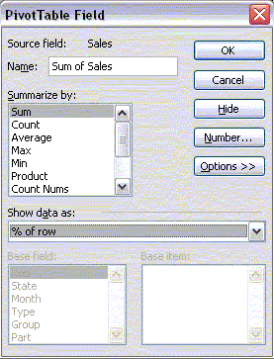
Field calculations
Select a cell anywhere on the Pivot Table and call the Pivot Table Wizard.
Sum of Sales is shown in the Data area, Double-Click this.
Notice that you can show the sum of sales or the count of the number of sales during a period, or several other calculations.
For now, leave the selection at Sum. Click on the Options button, then select % of row from the Show data as: dropdown list.

Slide 33
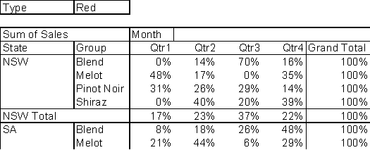
Now your Pivot Table shows sales in each quarter as a percentage of the full year.
You can easily see, for example, that sales of SA blends have steadily improved over the year.
Notes:
The EG4.XLS file contains the completed Pivot Table at the end of this lesson (in Sheet2). Sheet3 also contains a Pivot Table with multiple Page Fields. Open this to see how you might use Pivot Tables to home in on only the data you are interested in.

Slide 34
Pivot Tables based on external data
You can also use data that is stored in an external database or even a text file to populate a Pivot Table.
Data - Pivot Table… to call the Pivot Table Wizard.
In Step 1, choose the External Data Source option;

Slide 35
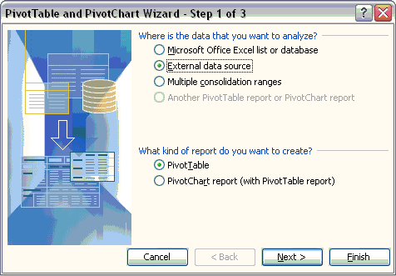
Click the Next button, the dialog box tells you that no data fields have been retrieved.
You cannot proceed until you press the Get Data button.

Slide 36
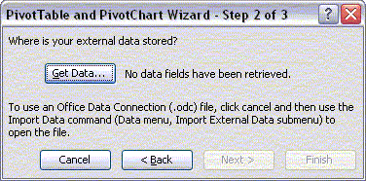
Click the Get Data button now.

Slide 37
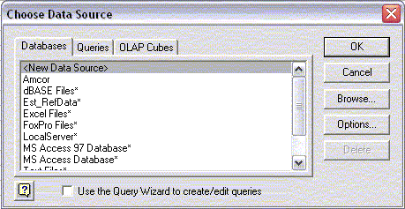
Excel will ask you to select a data source.
Select "New Data Source" from the list and Click OK.

Slide 38
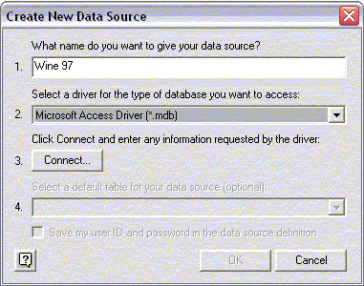
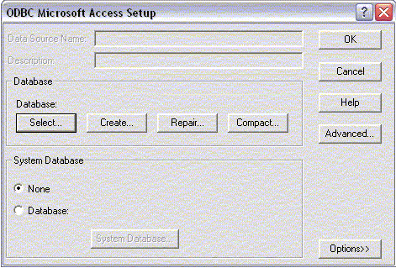
Another dialog will appear.
In box 1, give your new data source a name.
You can type whatever you like here, but just use "Wine 97" for now.
In box 2, select Microsoft Access Driver from the list of types of databases, Then Click the Connect… button.
In the next dialog box, Click the Select… button.

Slide 39
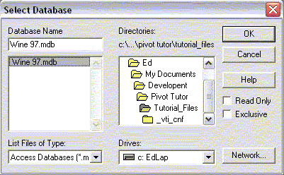
At last, you are asked to find the database from your directory tree.
Find the database by using the drive and directory boxes.

Slide 40
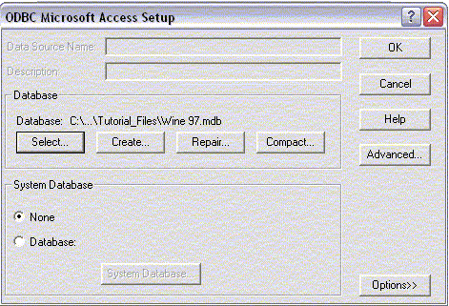
You are back to the previous dialog, except that now the Database group includes the path and filename of your database.

Slide 41
Click OK.
You go back to the "Create New Data Source" dialog.
Step 3 is now filled in.
Step 4 is optional, so we'll forget it.
Click OK. Now Wine 97 appears in the list of data sources you have available. Make sure you leave the "Use Query Wizard" option unchecked, select Wine 97 and Click OK.
You can use the query Wizard later on if you like, but you will have to learn how to use it yourself. Personally, I prefer to use Microsoft Query on its own.

Slide 42
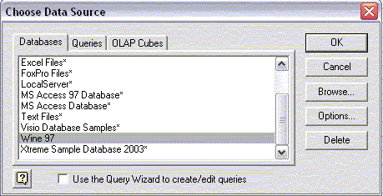

Slide 43
You now enter Microsoft Query.
This is a utility that builds SQL (Structured Query Language, pronounced "sequel") commands.
SQL commands are recognized by many database programs, such as Access or Paradox.
SQL commands tend to be long and difficult to write, so Microsoft Query handles the syntax for you.

Slide 44
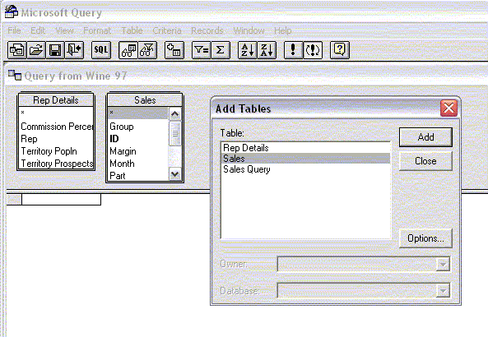
Select Rep Details and Click the Add button.
Then select Sales and click the Add button.
You should see the tables appearing in the background as you do this.
Most Access databases will have a few Tables and Queries that you do not need to show in your Pivot Table.
In this example, we do not want to add "Sales Query", so Click the Close button now.

Slide 45
You can size the two table boxes by Click-and-Dragging on their outside edges.
Try this until you can see the fields in each Table clearly.
You can also Click-and-Drag the horizontal divider to give yourself more room in the upper pane.
Now Click the Field Rep in the Rep Details Table and Drag to the Field Rep in the Sales Table.
A line will appear joining the two Tables.
You have just created a relationship between the Tables.
In the Sales Table, Double - Click the Rep, Month, State, Group, Sales, and Margin Fields. In the Rep Details Table, Double - Click the Commission Percent Field.
As you Double - Click each Field, it appears in the lower pane. These are the Fields that will be returned to your Pivot Table.

Slide 46
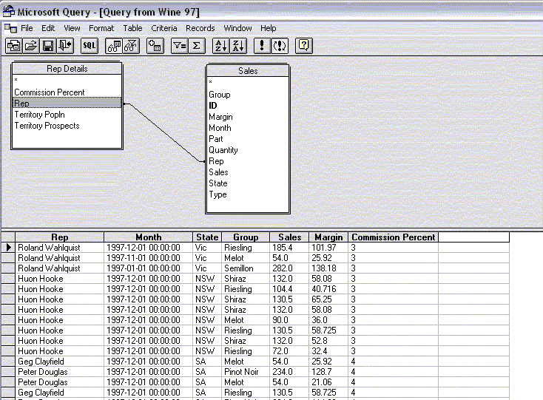

Slide 47
You can also use criteria in Microsoft Query to place limits on the data you bring into the Pivot Table.
Use the menu item Criteria-Add Criteria…
In the Field list, select Sales.Month.
Then Click the Values button and a list of the available months will be shown, select November and Click OK, then Click the Add button and the Close button.

Slide 48
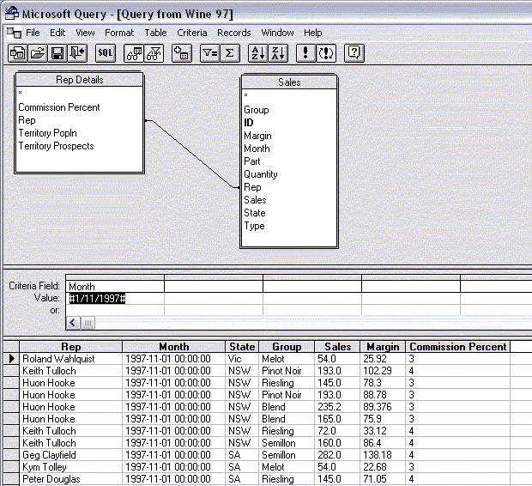

Slide 49
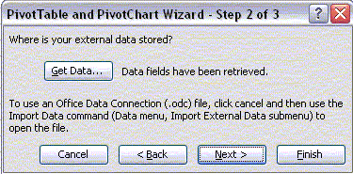
Use the menu item File - Return Data to Microsoft Office Excel (or use the toolbar button).
Now the data fields have been retrieved.
You are back to Step 2 in the Pivot Table Wizard.

Slide 50
Click the Next button.
Step 3 of the Pivot Table Wizard appears, click the "Layout" button - now the layout shows the Fields you have brought in from Access.
Drag the Month Field to the Page area, the State, and Rep fields to the Row area, the Commission Percent Field to the Column area, and the Sales field to the Row area.

Slide 51
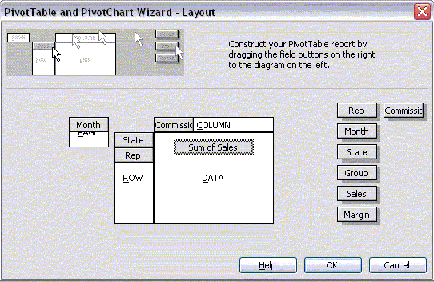

Slide 52
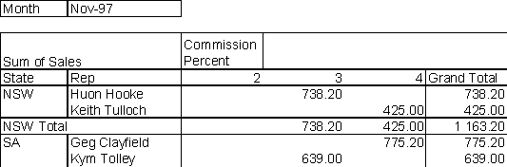

Slide 53
Pivot Tables based on external data can use a great deal of memory.
By default all the records sourced from the external data are stored in the Pivot Table cache which is stored with the Excel workbook.
Watch the size of your Excel file when saving a workbook containing one or more of these Pivot Tables.
It is possible to save a Pivot Table without saving the underlying data.
Look at the "Options" button in Step 3 of the Pivot Table Wizard.
However, any changes to the Pivot Table will then result in Excel having to read the original data from the external database again.
This can be a time consuming operation for large data sets.
It becomes a question of trading memory for speed - finding the right balance is largely a matter of trial and error

Slide 54
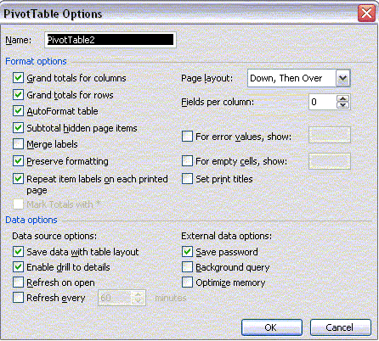

Slide 55
Using Pivot Tables to consolidate data
Assume that each sales rep prepares a monthly forecast of his sales by wine type.
Suppose that, with a bit of training, we could get the sales reps to email the forecast in a common format.
EG6.XLS contains separate worksheets for forecasts from four sales reps.

Slide 56
It is then possible to use a Pivot Table to sum all the forecasts.
EG6.XLS. Sheet1 to Sheet4 contain forecasts in the above format for four sales reps.
The sheet named Totals is blank.
Select cell A2 in Totals.
Start the Pivot Table Wizard and, in Step 1, choose Multiple Consolidation Ranges;

Slide 57
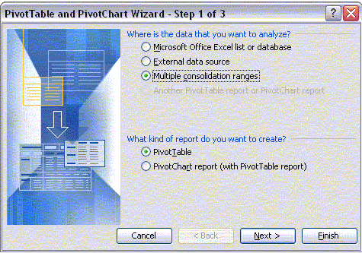
Click the Next button. Let Excel "Create a single Page field" for you then click the Next button.

Slide 58
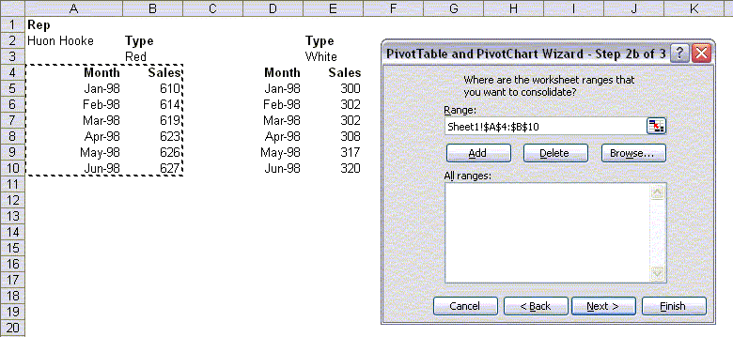
Place the cursor in the Range box, Click the Sheet1 worksheet tab, and select the range A4:B10. Then Click the Add button.

Slide 59
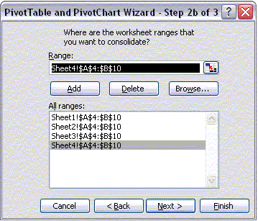
Now Click the Sheet2 worksheet tab.
The range A4:B10 is already selected for you, so just Click the Add button.
Do the same for Sheet3 and Sheet4.
The dialog should now look like this;

Slide 60
Click the Next button.
The Layout is already set up for you.
Click the "Options" button, uncheck the "GrandTotal for Rows" option, and click "Ok".
Place the Pivot Table in the existing worksheet in starting cell A2, click "Finish".
You have just summed the forecasts for red wines so place the heading "Red Wines" in cell A1.
Repeat these steps, consolidating range D4:E10 in a Pivot Table starting in cell C2.
The completed example is given in EG7.XLS.

Slide 61
Using Calculated Fields
It is easy to add fields to a Pivot Table that are a function of other fields.
This is most useful when the data source is external to the workbook.
For example, open EG5.XLS again and select a cell anywhere within the Pivot Table.
Then use the menu on the Pivot Table toolbar Pivot Table-Formulas-Calculated Fields.
The following dialog appears.

Slide 62
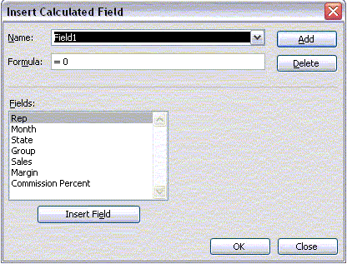

Slide 63
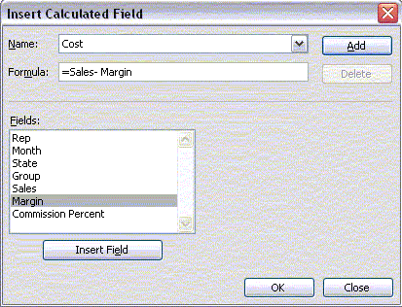
Add a field that calculates the total cost for each record.
Type "Cost" in the Name box, double-click "Sales" in the Fields box, the Formula box changes to "=Sales", then type a minus sign and double-click "Margin".
Now click the Add button.
The dialog should look like this.

Slide 64
Cell References to a PivotTable
GETPIVOTDATA function appears automatically when you type an equal sign (=) outside of the report and then select a cell inside the report
  If you remove any of the fields referenced in the GETPIVOTDATA formula from the report, the formula returns #REF!.
  If you do not want to use the function:
    Type an equal sign (=) in a cell outside of the report.
    Type the cell address that contains the value that you want to reference.

Slide 65

Creating Pivot Charts
Click the chart button to create chart

Slide 66
Some information in these slides is from the Microsoft Training Webpage: http://office.microsoft.com/en-us/training/ default.aspx
Copyright © 2004 Microsoft Corporation, One Microsoft Way, Redmond, Washington 98052-6399 U.S.A. All rights reserved.

Slide 67
Exporting to Power Point
If you just want to get a Pivot Chart onto a PowerPoint slide as quickly and easily as possible, you can hide the field headings by selecting the “Pivot Table” down arrow on the Pivot Table toolbar, then selecting “Hide Pivot Table field buttons.”
Select the whole chart by clicking on the white space (not on any particular chart element), copy, go to your PowerPoint slide and either paste.

